Slide 1
4.1.1.1 Data types

Slide 2
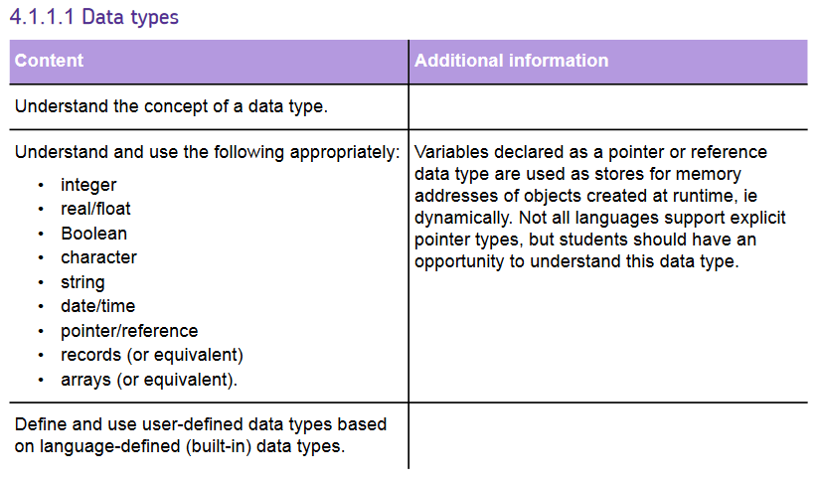
Specification

Slide 3
Learning objectives
To understand the different data types:
Integer
Real/float
Boolean
Character
String
Date/time
Pointer/reference
Records (or equivalent)
Arrays (or equivalent)
To be able to program all of the above data types.
To know when to use each of the above data types.

Slide 4
Do now: Data types
What data types do you remember from GCSE programming?

Slide 5
Data types – your one note
Key term | Explanation | Python example
Integer
Real/float
Boolean
Character
String
Date/time
Records (or equivalent
Arrays (or equivalent)

Slide 6
Integer
Whole number
No decimal points
Uses int() in Python

Slide 7
Real/float
Decimal point number
Still not always accurate due to the amount of bits Python uses to store numbers but more accurate than and Integer as it allows decimal point numbers – you will do a lot of this with Miss Clapham about how numbers are stored in a computer and accuracy etc!
Uses float() in Python

Slide 8
Boolean
One of 2 values
Yes/No, True/False, On/Off 1/0 etc.
Usually use True or False (with caps) in Python

Slide 9
character
An individual character – like when you did character sets in KS4
Remember a character can be a symbol, number, space or a letter – any printable character the computer recognises
Can use chr() in Python – example chr(90) returns A as this is the ASCII value for the number 90

Slide 10
string
Multiple characters together
A word or sentence or multiple numbers and symbols etc. together
Uses str() in Python

Slide 11
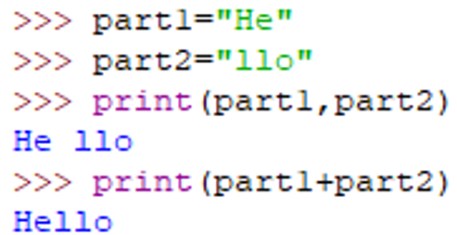
Strings- print vs concatenate
Which of the below demonstrates printing and which demonstrates concatenation?
Printing – just uses a comma in between variables.
Concatenation – uses a + in between to actually put the variables together

Slide 12
Strings – escape sequences
What is the purpose of the following escape sequences?
Print them within a string, in the speech marks and see what each does!
\n
\t
\\
\”
“”” text
here “””

Slide 13
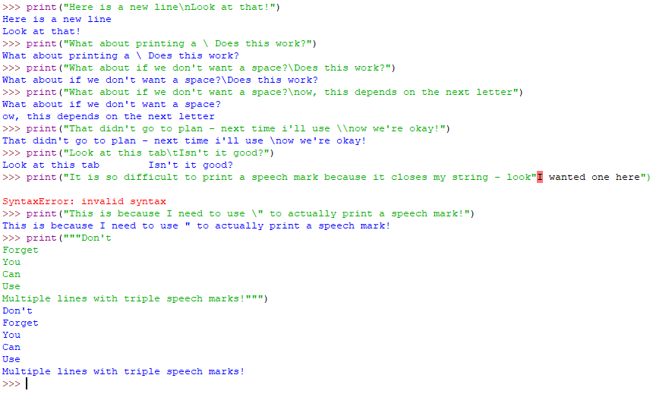
Strings – escape sequences

Slide 14
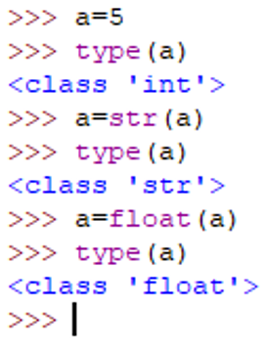
Data types - casting
Casting just means switching between data types:

Slide 15
Date/time
There are different modules you can use in Python for date time – we will do a little bit of work on one of these modules but there are others.
Essentially, the computer usually stores the current time and date as the amount of seconds that have happened since January 1st 1970 and all calculations are done around this.

Slide 16
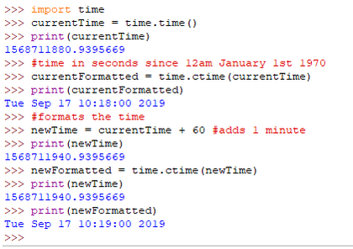
Date/time examples

Slide 17
Data types – your one note
Key term | Explanation | Python example
Integer
Real/float
Boolean
Character
String
Date/time
Records (or equivalent)
Arrays (or equivalent)
Whole number – no decimal points
num=6 num=int(6)
Decimal point number
num=6.4 num=float(10.3)
One of two values
True False
Single printable element from a keyboard.
letter=“S” symbol=“%”
Multiple characters together
word=“cheese” pass=“1ndj!*”
Different modules for this – stores the current date/time
import time new=time.time()

Slide 18
Pointer/reference
Variables declared as a pointer or reference data type are used as stores for memory addresses of objects created at runtime, ie dynamically.
Not all languages support explicit pointer types, but students should have an opportunity to understand this data type.
Think about when we reference an item in a list – the pointer would be like the index value in Python.

Slide 19
Records (or equivalent)
There are different ways to store records, the one you would be most familiar with is a 2D array:
Students=[[“Alan”,17],[“Dave”,18],[“Steve”,16]]
So each of these is a record.

Slide 20
Arrays (or equivalent)
You will have looked at 2 or 3 in KS4.
Python doesn’t do arrays in the same way as other programming languages.
3 options for an array in Python, we are going to look at each in detail:
Tuple
List
Dictionary

Slide 21
Tuple
Tuples use normal braces – ()
Tuples CANNOT be changed a run time – you can go back into the code and change them but once you have run the program, you can’t add, change, update or delete an item.
Example:
myTuple=(“Monday”, “Tuesday”, “Wednesday”, “Thursday”, “Friday”, “Saturday”, “Sunday”)
You can print individual elements but that is about it!
Make a tuple, print some individual elements and try to change something!
Add this to your notes.
Index positions:
0
1
2
3
4
5
6

Slide 22
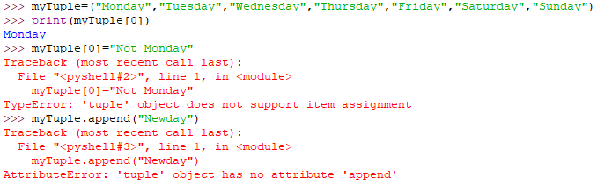
Tuples - unchangeable

Slide 23
Part 2

Slide 24
starter
Lists and tuples are both examples of _ _ _ _ _ _
What is the difference between a list and a tuple?
Tuples are _ _ _ _ _ _ _ _ _ _ _

Slide 25
listS
Lists use square brackets – []
Lists CAN be changed a run time – you can add, change, update or delete an item.
Example:
myList=[“Dog”, “Cat”, “Fish”, “Donkey”]

Slide 26
LIST OPERATIONS – PROGRAM THESE AND FIND OUT WHAT ALL OF THEM DO!
Initialising
Updating
Appending
Inserting to a position
Removing an item (value based)
Popping an item (returns last)
Popping a particular item (returns)
Deleting on location
Clearing a list
Deleting a list
Indexing items in a list
Reversing a list
Ordering a list
Extending a list
Concatenating lists
Slicing lists
Turn a string into a list
Creating a 2d array
Creating a 3d array

Slide 27
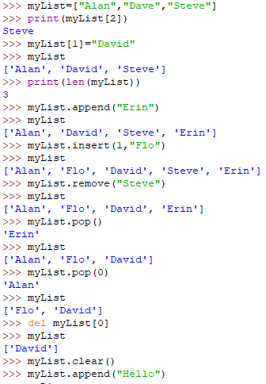
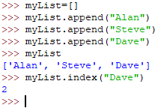
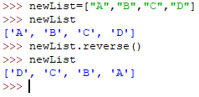
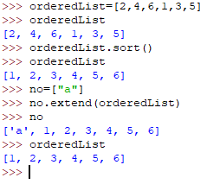
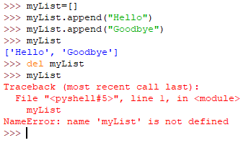
LIST EXAMPLES

Slide 28
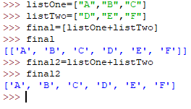


LISts – concatenate and slicing

Slide 29
2D arrays
Remember you can have 2D, 3D, 4D arrays by putting lists inside lists inside lists!
Example:
students=[[“Alan”,17],[“Dave”,18],[“Steve”,16]]
How would you print the name “Steve”?
print(students[2][0])

Slide 30
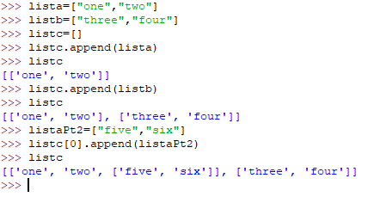
LISts – 2d and 3d lists

Slide 31
Part 3

Slide 32
starter
State the most appropriate data type for each of the following
12.76
“Tea”
12:06
-17
False
Float
String
Date/Time
Integer
Boolean

Slide 33
starter
Solve the anagrams:
srntig
rraay
cahatrecr

Slide 34
starter
What data types should be used for the following:
Name

Slide 35
starter
What data types should be used for the following:
Age

Slide 36
starter
Give 2 types of array

Slide 37
starter
Which array uses [] ?

Slide 38
starter
Which array uses () ?

Slide 39
starter
What is the difference between a list, tuple and dictionary?

Slide 40
Dictionary
Dictionaries use curly braces - {}
Dictionaries CAN be changed a run time – you can add, change, update or delete an item.
What is the key difference between a dictionary and a list?
Dictionaries DO NOT use index positions – the key is what we use to index something.
Example:
mydictionary={“Good Day”:“a formal greeting”, “Laters”:“not so formal goodbye”}
print(mydictionary[“Good Day”]) would return “a formal greeting”.
print(mydictionary[0]) would return an error because there is no key of “0”

Slide 41
dictionary
It uses a key value pair, separated by a colon.
mydictionary={“Good Day”:“a formal greeting”, “Laters”:“not so formal goodbye”}
Keys have to be unique but the data can be the same.

Slide 42
dictionary
Create
Print
Add
Update
Delete
Find length
Pop
Print all key value pairs – not just values
Clear the dictionary
Delete the entire dictionary
Sort it (sorted())
Store a list in a dictionary
Printing a key after you have typed in a value
Check for a value in the dictionary or print a message if the value is not
Return all the keys
Return all the values

Slide 43
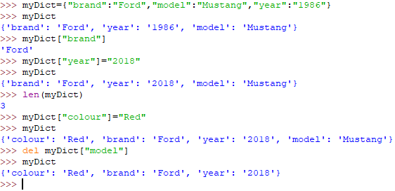
dictionary

Slide 44
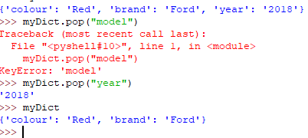
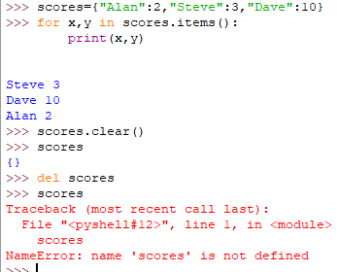
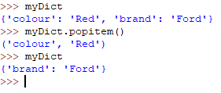
dictionary

Slide 45

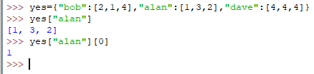
dictionary

Slide 46
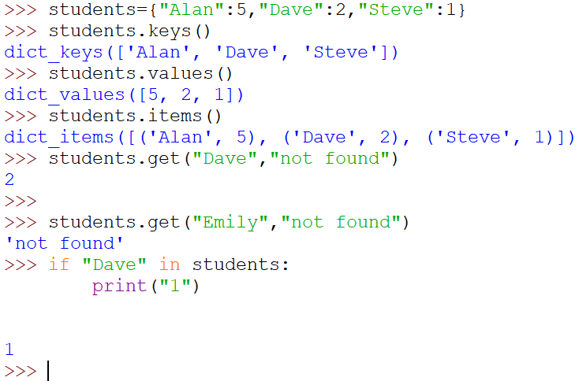
dictionary

Slide 47
Data types – your one note
Key term | Explanation | Python example
Integer
Real/float
Boolean
Character
String
Date/time
Records (or equivalent)
Arrays (or equivalent)
Whole number – no decimal points
num=6 num=int(6)
Decimal point number
num=6.4 num=float(10.3)
One of two values
True False
Single printable element from a keyboard.
letter=“S” symbol=“%”
Multiple characters together
word=“cheese” pass=“1ndj!*”
Different modules for this – stores the current date/time
import time new=time.time()
Use of arrays/multi dimensional arrays
Tuple () List [] Dictionary{}
Three different types in Python
Tuple () List [] Dictionary{}

Slide 48
Check your knowledge
Spot the errors in the code:
nameinput(“What are you called?”)
print(“Hello”, name)
ans=input(“What is the capital of England?”)
if *** ==“London” ** ans==“london”:
print(“Well done”)
**** ans== “L”:
print(“Very funny!”)
else:
print”Not quite”
1
2
3
4
5

Slide 49
Check your knowledge
name=input(“What are you called?”)
print(“Hello”, name)
ans=input(“What is the capital of England?”)
if ans ==“London” or ans==“london”:
print(“Well done”)
elif ans== “L”:
print(“Very funny!”)
else:
print(”Not quite”)

Slide 50
Check your knowledge
Spot the errors in the code:
hours = input("Input hours parking required (2, 4 or 12): ")
numSecs = hours *60*60
if hours = 2:
charge = 3.50
elif hous == 4:
charge = 5.00
elif:
charge = 10.00
1
2
3
4

Slide 51
Check your knowledge
Spot the errors in the code:
hours = int(input("Input hours parking required (2, 4 or 12): "))
numSecs = hours *60*60
if hours == 2:
charge = 3.50
elif hours == 4:
charge = 5.00
else:
charge = 10.00
1
2
3
4

Slide 52
Check your knowledge
name=input(“what are you called?”)
print(“hello”, name)
ans=input(“what is the capital of england?”)
if ans ==“London” or ans==“london”:
print(“well done”)
elif ans== “L”:
print(“aren’t you funny?!”)
else:
print(”not quite”)
What would improve the standard of this code?
Comments
Variable names

Slide 53
Check your knowledge
How could this code be more efficient?
.upper()
.lower()
name=input(“what are you called?”)
print(“hello”, name)
ans=input(“what is the capital of england?”)
if ans ==“London” or ans==“london”:
print(“well done”)
elif ans== “L”:
print(“aren’t you funny?!”)
else:
print(”not quite”)

Slide 54
1-3 tasks

Slide 55
Tasks
Test Data –
1 hour should cost £3.50 and should add an hour on to the current time
4 hours should cost £5.00 and should add 4 hours on to the current time
12 hours should cost £10.00 and add 12 hours onto the current time
14 hours should not be allowed and should produce an error message
Task 1:
Write a program to calculate car park charges. Up to 2 hours costs £3.50, up to 4 hours costs £5.00 and up to 12 hours costs £10.00.
The driver enters the number of hours they require and the machine prints the current time, expiry time and charge.
Example:
Time now: Wed Mar 8 15:47:46 2018
Expires: Wed Mar 8 03:37:47 2018
Charge: £10.00

Slide 56
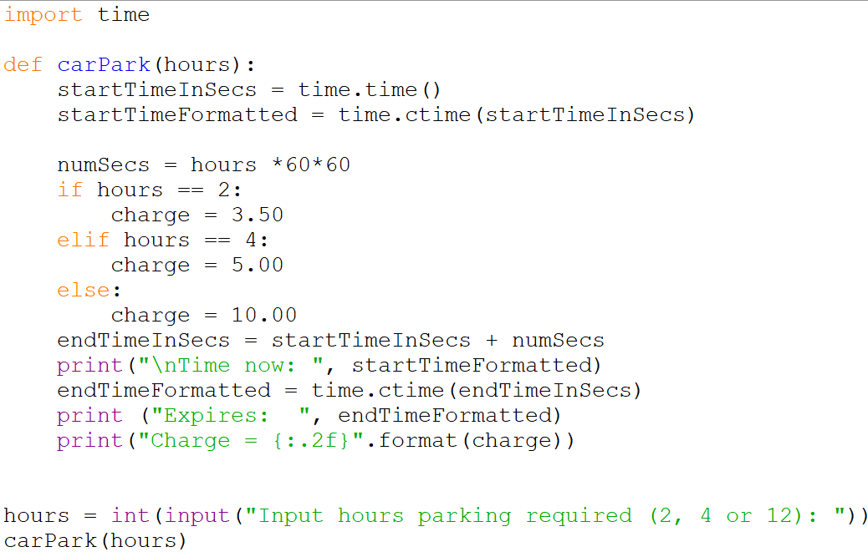
Example answer:

Slide 57
Tasks
Test Data –
Encrypt: HELLO with a key of 1 should produce IFMMP
Encrypt: ZEBRA with a key of 2 should produce BGDTC
Decrypt: JUHDW with a key of 3 should produce GREAT
Decrypt: CIPPSA with a key of 4 should produce YELLOW
Task 2:
Create a Caesar cipher program using a tuple rather than using chr() or ord(). Make sure it loops correctly and that it can encrypt or decrypt messages.
Extend this program by not providing the key and try to create a program that can decrypt a message without the key.

Slide 58
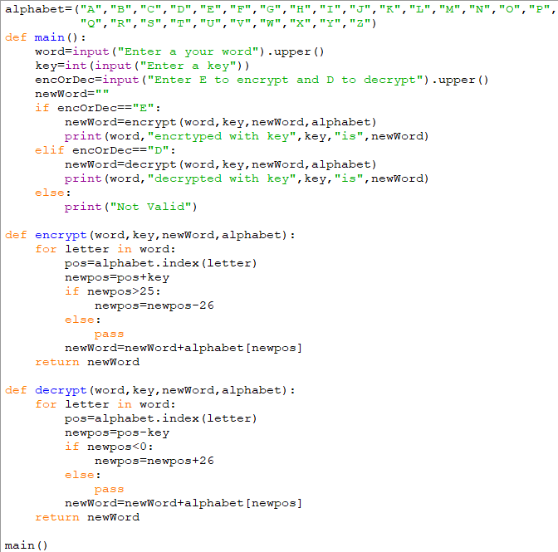
Example answer:

Slide 59
Tasks
Test Data –
AAA01 with score higher than 135 should update in the array
BBB01 with score lower than 87 should not update in the array
EEE01 with a random number should be appended to the array
Run through each value and produce a random number – if it is greater, it should update
Task 3:
Write a high scores program using a 2d array with these values:
Ask a user to enter their ID, Check if the userID exists in the list – if it is not found then it should append a new row containing the user ID and a score of 0.
Test this program:
Generate a random number between 50 and 200 to demonstrate a “new score” run through each person in the list and if this new score is greater than their previous score, update it.
Ensure you do this for every record in the list.
userID | topScore
AAA01 | 135
BBB01 | 87
CCC01 | 188
DDD01 | 109

Slide 60
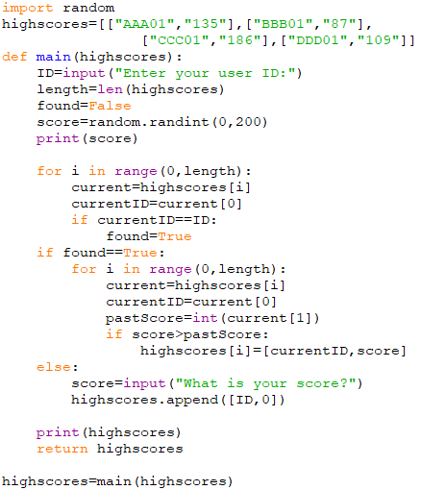
Example answer:

Slide 61
Data Type programming challenges

Slide 62
challenges
Sing Along
Create a program that prints the lyrics to the song ‘10 green bottles’ in as few lines of code as possible.
Extension:
1. Develop this program so that you can enter any starting number and it will count down from there
Speed Tracker
Create a program that takes a time for a car going past a speed camera, the time going past the next one and the distance between them to calculate the average speed for the car in mph. The cameras are one mile apart.
Try to add these:
Speed cameras know the timings of each car going past, through number plate recognition. Valid number plates are two letters, two numbers and three letters afterwards, for example XX77 787. Produce a part of the program that checks whether a number plate matches the given pattern. Tell the user either way.
Create a program for creating a file of details for vehicles exceeding the speed limit set for a section of road. You will need to create a suitable file with test data, including randomised number plates and times. You will then use the code you’ve already written to process this list to determine who is breaking the speed limit (70mph) and who has invalid number plates.
Thief!
A thief has managed to find out the four digits for an online PIN code, but doesn’t know the correct sequence needed to hack into the account.
Design and write a program that displays all the possible combinations for any four numerical digits entered by the user. The program should avoid displaying the same combination more than once.
Fruit Machine
Write a program to simulate a Fruit Machine that displays three symbols at random from Cherry, Bell, Lemon, Orange, Star, Skull.
The player starts with £1 credit, with each go costing 20p. If the Fruit Machine “rolls” two of the same symbol, the user wins 50p. The player wins £1 for three of the same and £5 for 3 Bells. The player loses £1 if two skulls are rolled and all of his/her money if three skulls are rolled. The player can choose to quit with the winnings after each roll or keep playing until there is no money left.

Slide 63
Additional information and help

Slide 64
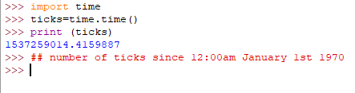
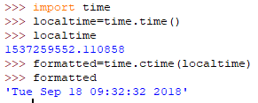
Time module

Slide 65

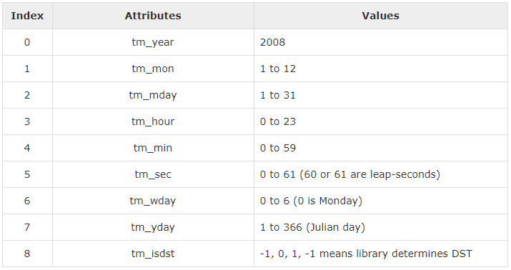
Time module

Slide 66

Time module

Slide 67
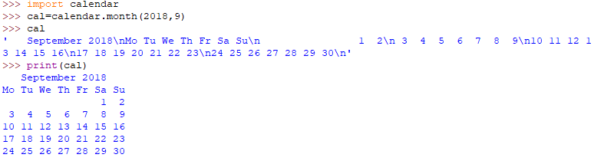
Time module

Slide 68
Links to further resources
Useful links:
https://www.w3resource.com/python/python-data-type.php

